Slide 1


Decision Support for Antibacterial Selection
Scott Campbell
James Campbell
An implementation overview of the Cancer Synoptic Reporting Working Group
Global terminology enabling quality information exchange

Slide 2
Decision Analytic Project Antimicrobial Stewardship
Deliver actionable advice to the clinician in real-time for prescribing indicated antibacterials for infections
Step-by-step:
Identify the bacteria (the bug) that are causing the infection
Profile the antibiotic susceptibility of that species of bacteria
Pick an antbiotic for treatment to which the bacterium is likely susceptible for which the patient has no allergy

Slide 3
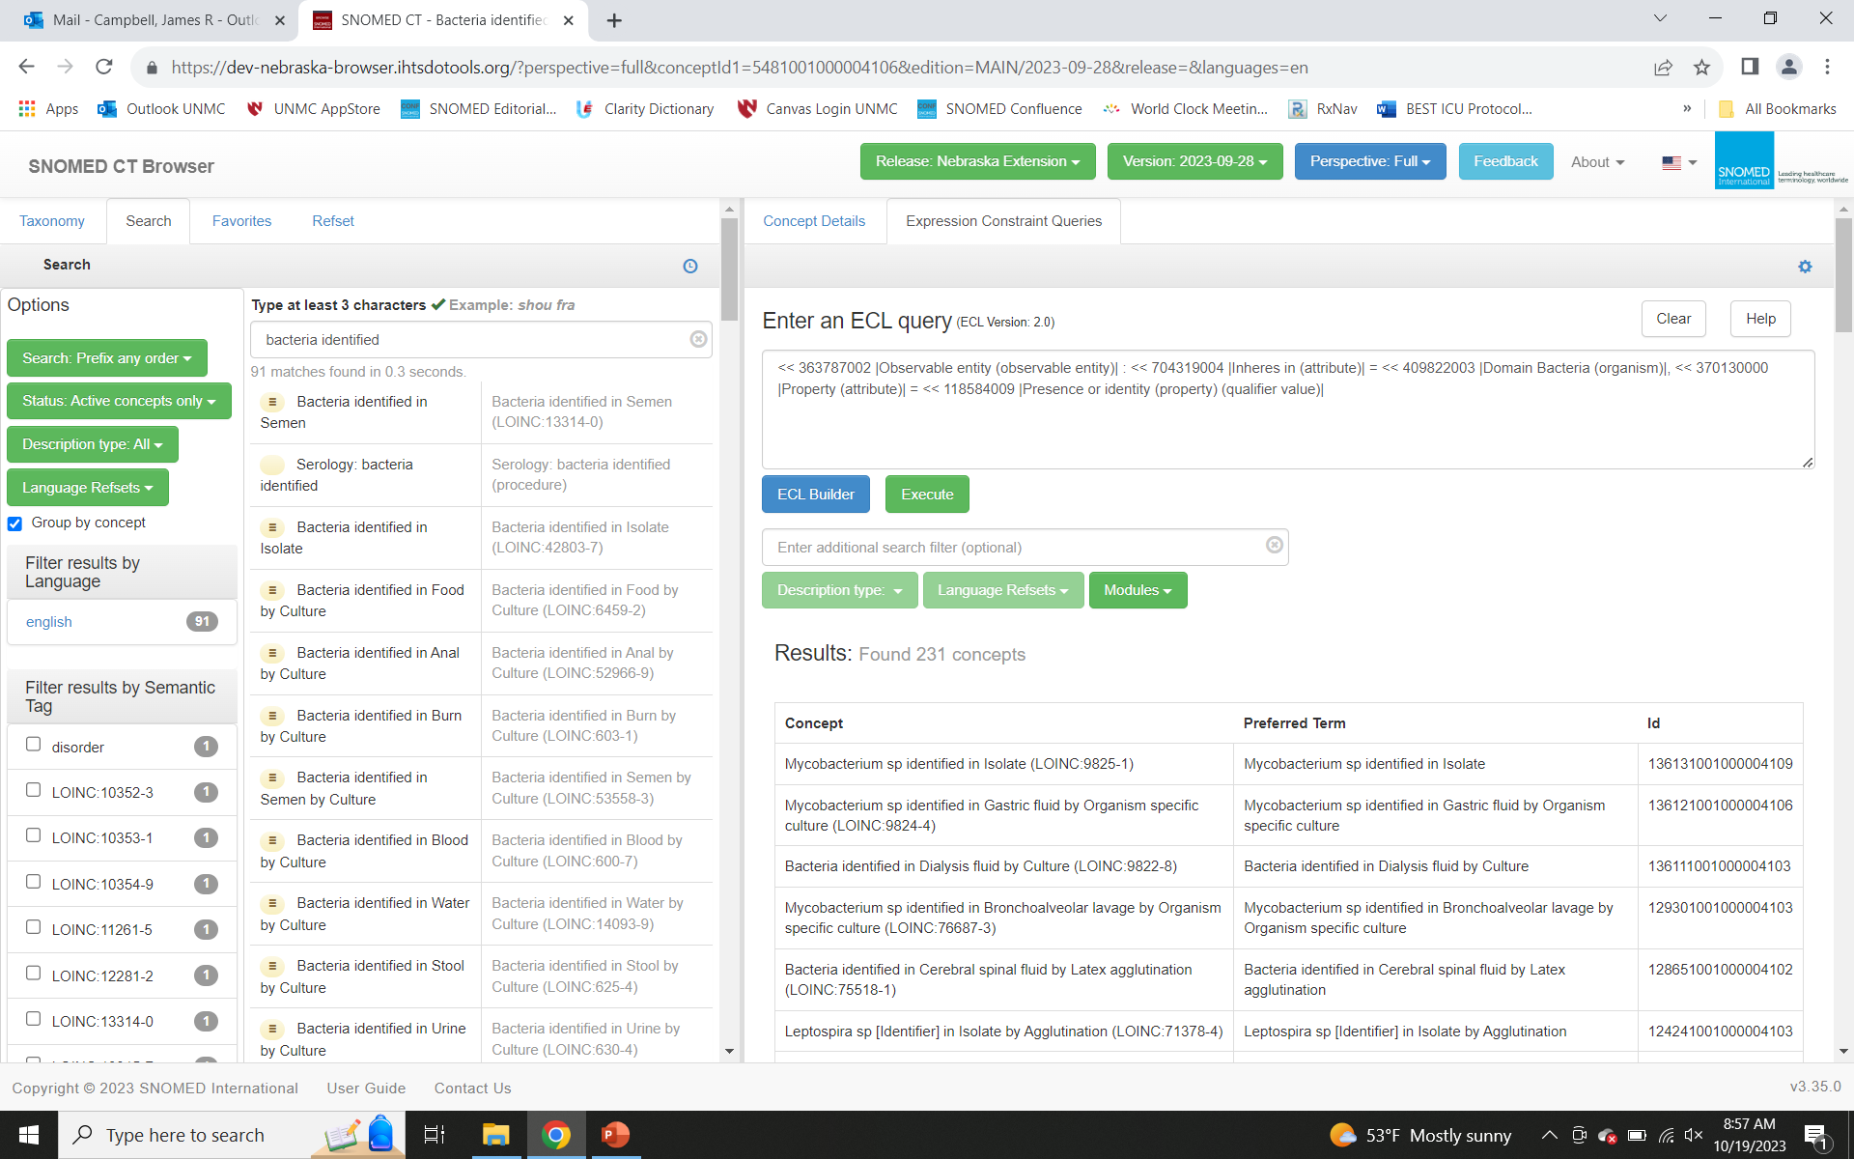
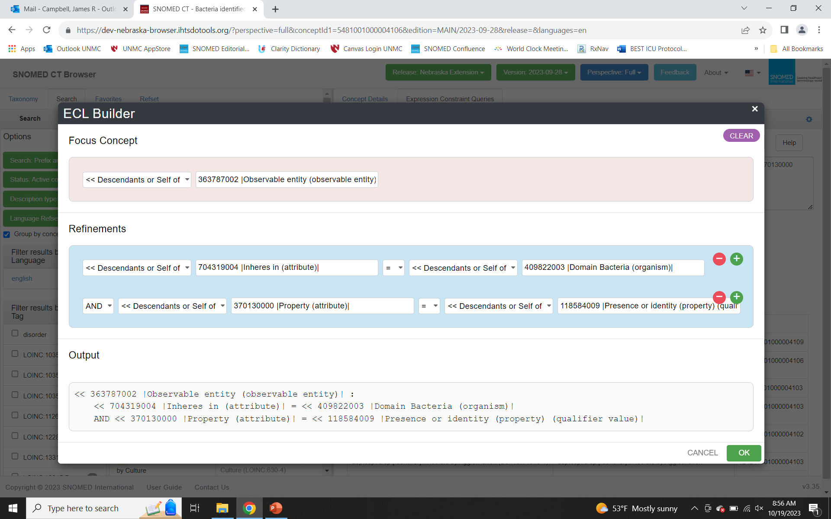
Decision Analytic Project Antimicrobial Stewardship
Deliver actionable advice to the clinician in real-time for prescribing indicated antibacterials for infections
Step-by-step:
Identify the bacteria (the bug) that are causing the infection
Profile the antibiotic susceptibility of that species of bacteria
Pick an antbiotic for treatment to which the bacterium is likely susceptible for which the patient has no allergy

Slide 4
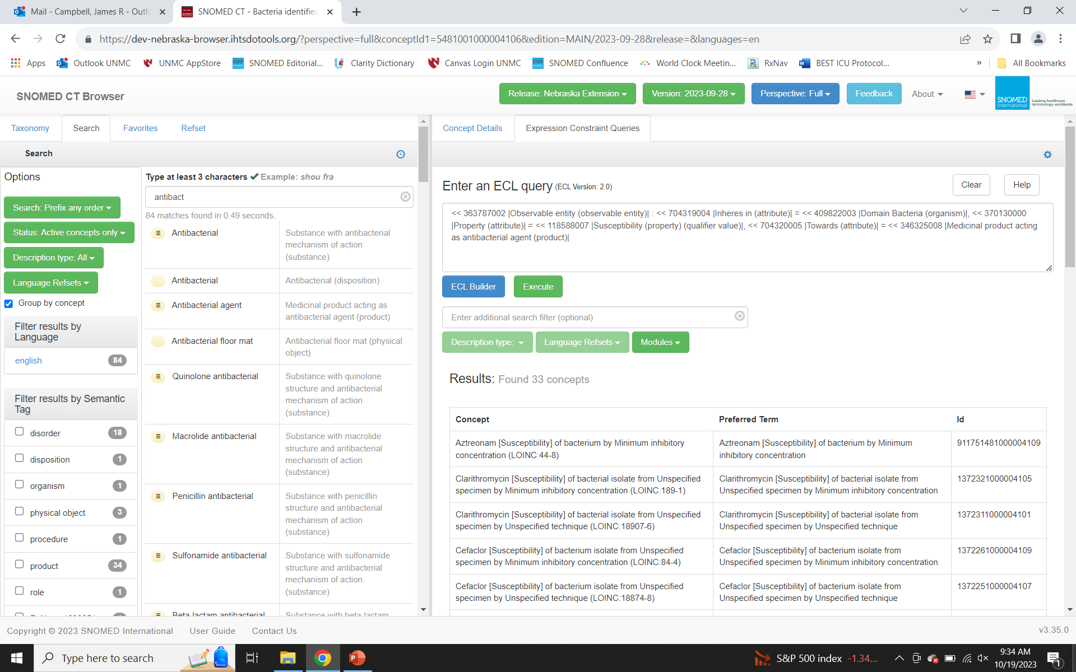
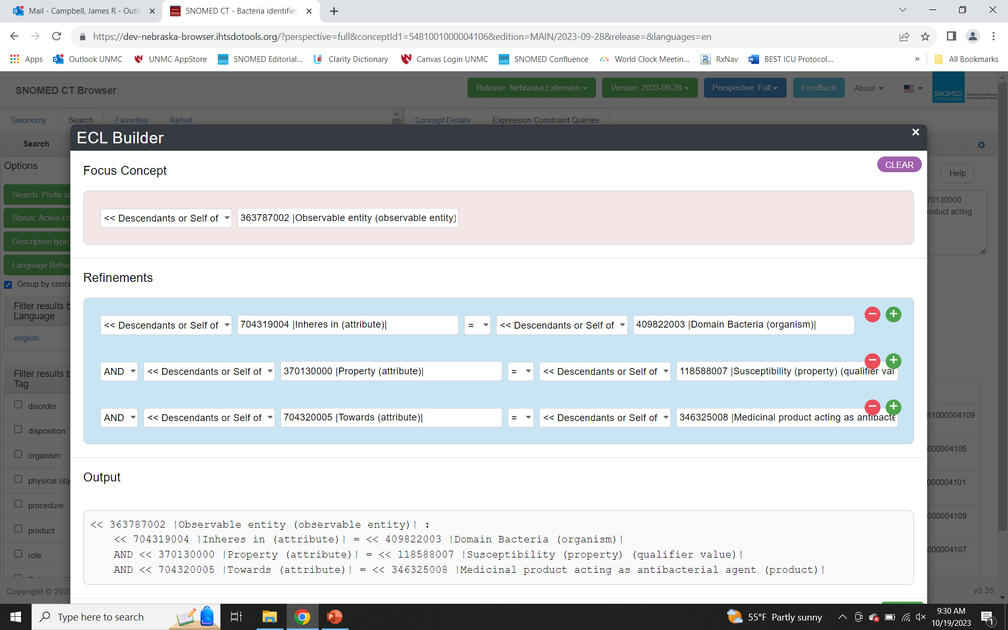
Decision Analytic Project Antimicrobial Stewardship
Deliver actionable advice to the clinician in real-time for prescribing indicated antibacterials for infections
Step-by-step:
Identify the bacteria (the bug) that are causing the infection
Profile the antibiotic susceptibility of that species of bacteria
Pick an antbiotic for treatment to which the bacterium is likely susceptible for which the patient has no allergy

Slide 5
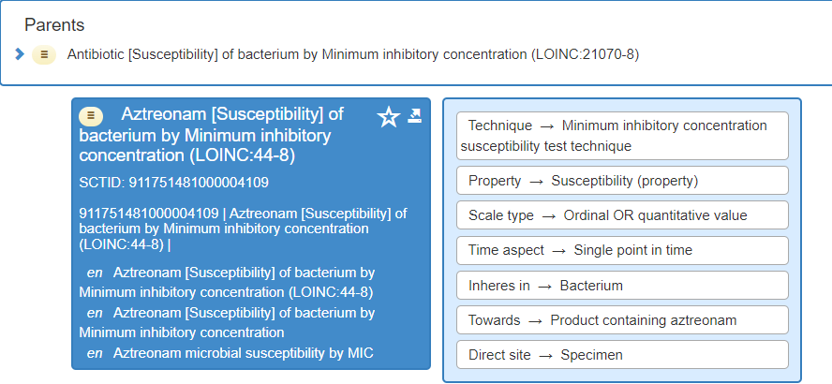
Each Susceptibility Points to Antibacterial Class

Slide 6
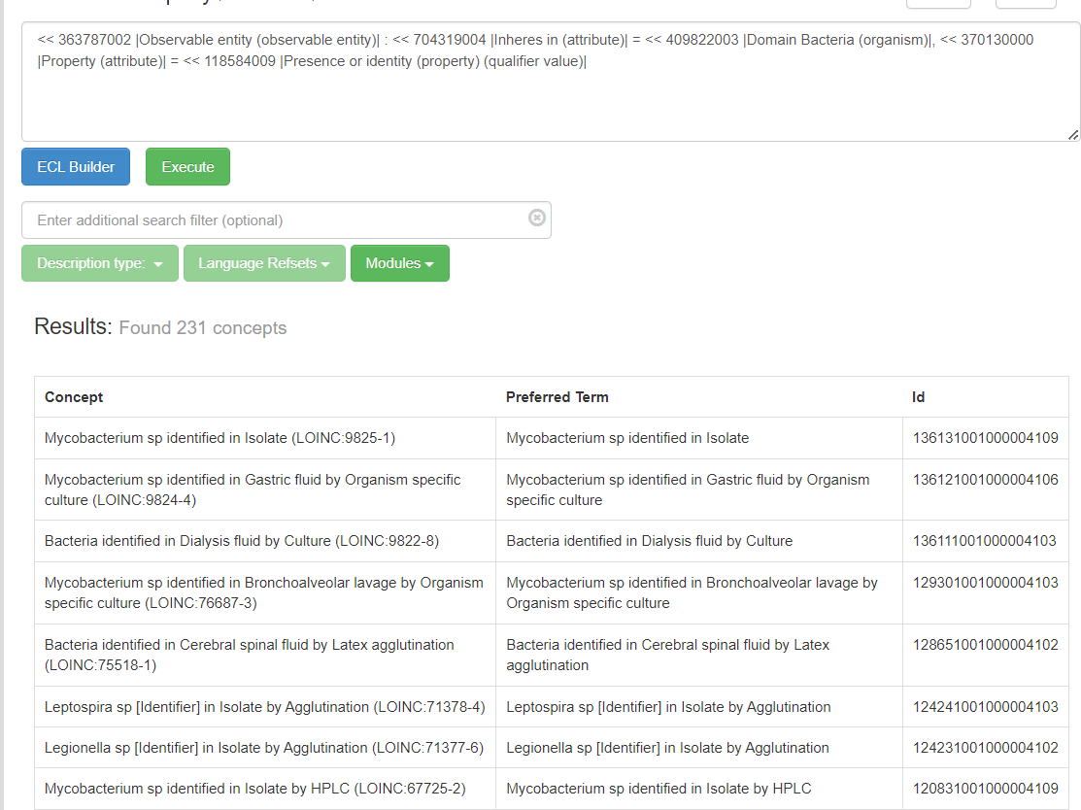
Decision Analytic Project Antimicrobial Stewardship
Deliver actionable advice to the clinician in real-time for prescribing indicated antibacterials for infections
Step-by-step:
Identify the bacteria (the bug) that are causing the infection
Profile the antibiotic susceptibility of that species of bacteria
Pick an antbiotic for treatment to which the bacterium is likely susceptible for which the patient has no allergy

Slide 7
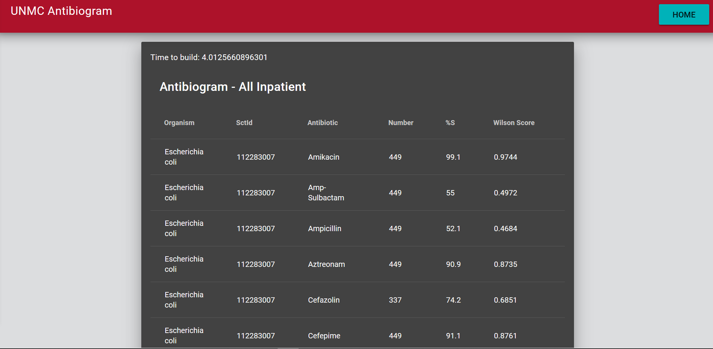
Compile susceptibility data into Antibiogram Bacterial species by susceptibility rate

Slide 8
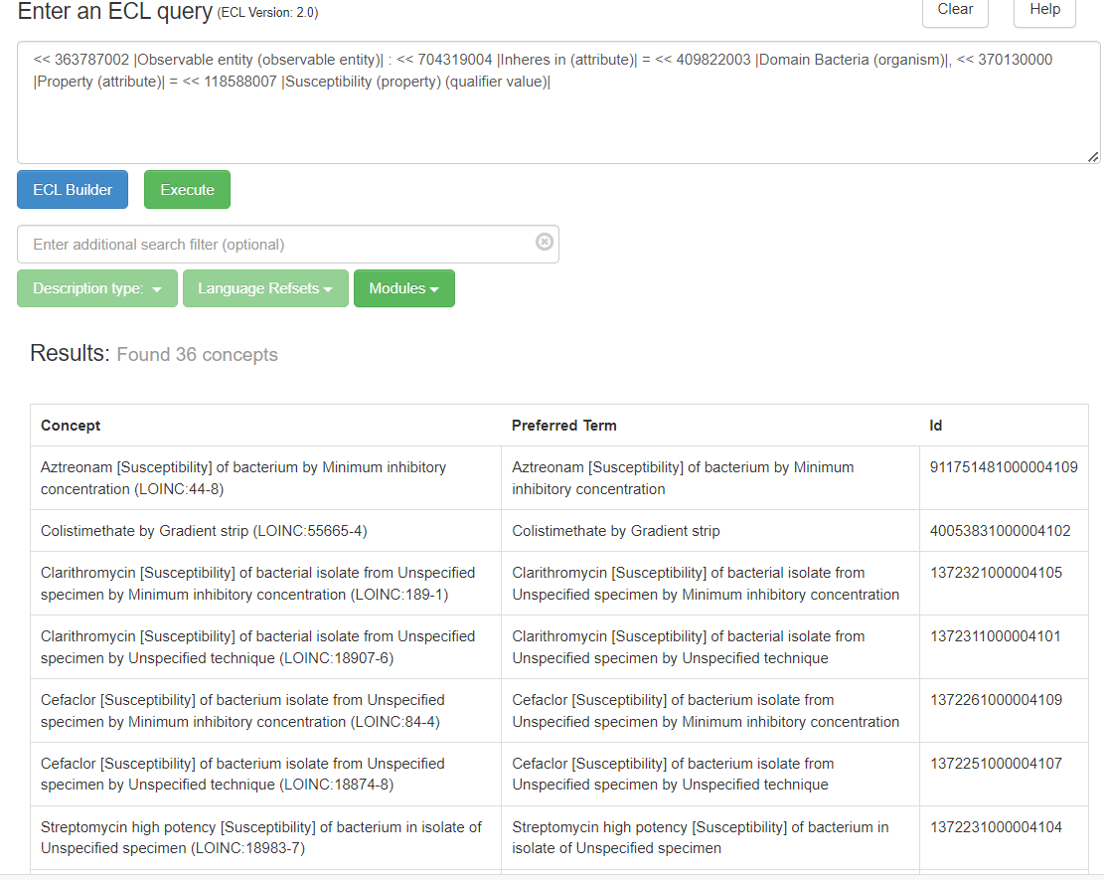
Decision Analytic Project Antimicrobial Stewardship
Deliver actionable advice to the clinician in real-time for prescribing indicated antibacterials for infections
Step-by-step:
Identify the bacteria (the bug) that are causing the infection
Profile the antibiotic susceptibility of that species of bacteria
Pick an antbiotic for treatment to which the bacterium is likely susceptible for which the patient has no allergy

Slide 9
Decision Analytic Project Antimicrobial Stewardship
Deliver actionable advice to the clinician in real-time for prescribing indicated antibacterials for infections
Step-by-step:
Identify the bacteria (the bug) that are causing the infection
Profile the antibiotic susceptibility of that species of bacteria
Pick an antbiotic for treatment to which the bacterium is likely susceptible for which the patient has no allergy
SUSCEPTIBILITY DATA SUPPORTS AZTREONAM OR AMOXICILLIN,
CLINICAL SITUATION CALLS FOR INTRAVENOUS THERAPY
((<< 69918003 |Product containing aztreonam (medicinal product)| OR << 27658006 |Product containing amoxicillin (medicinal product)|) : << 411116001 |Has manufactured dose form (attribute)| = << 385287007 |Parenteral dose form (dose form)| ) {{ term = "RXNORM", type = fsn }}

Slide 10
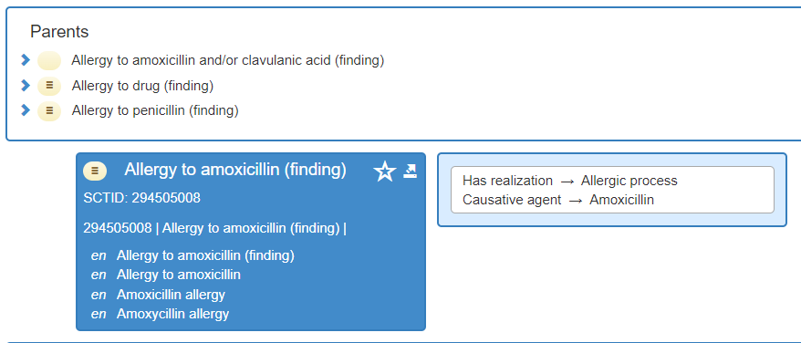
Decision Analytic Project Antimicrobial Stewardship
Deliver actionable advice to the clinician in real-time for prescribing indicated antibacterials for infections
Step-by-step:
Identify the bacteria (the bug) that are causing the infection
Profile the antibiotic susceptibility of that species of bacteria
Pick an antbiotic for treatment to which the bacterium is likely susceptible for which the patient has no allergy (in problem list)
IDENTIFIES ALL THE ANTIBACTERIAL SUBSTANCES WHICH ARE LISTED AS ALLERGIES
( <<609328004 |Allergic disposition (finding)| . 246075003|Causative agent| ) AND ( <<419241000|Substance with antibacterial mechanism of action|)

